Slide 1


BQMS
BIDDING & QUOTATION
MANAGEMENT SYSTEM
[Vendor Portal]
Vendor Info./Doc. Submission
Notes:
Hello, everyone. Welcome to indirect Procurement System e-Learning course
for Marketing area of BQMS System.
This is chapter 4, Vendor Selection, Quotation and Bidding

Slide 2
■ Table of contents
Vendor Account Registration
A. Registartion with BQMS Code
B. Registartion without BQMS Code
Info/Doc. Request Status and Submission
A. Vendor Info. Submission
B. Doc. Submission
3. Confirmation Vendor Information Reflection

Slide 3
Vendor Account Registration Process
Vendor | Samsung Person in Charge
Click ‘Vendor Info/Docs. Submission Guide’
Sending registration request mail
T&C agreement
Input vendor basic info
Sign up for vendor admin account and approval request
whether approve use
Sign in
approval
Finish

Slide 4
Vendor Info/Doc. Submission Process
Vendor | Samsung Person in Charge
Request for Vendor Info
Submission of vendor info
Request for Documents
Submission of required doc.
Registration procedure
Registration complete

Slide 5
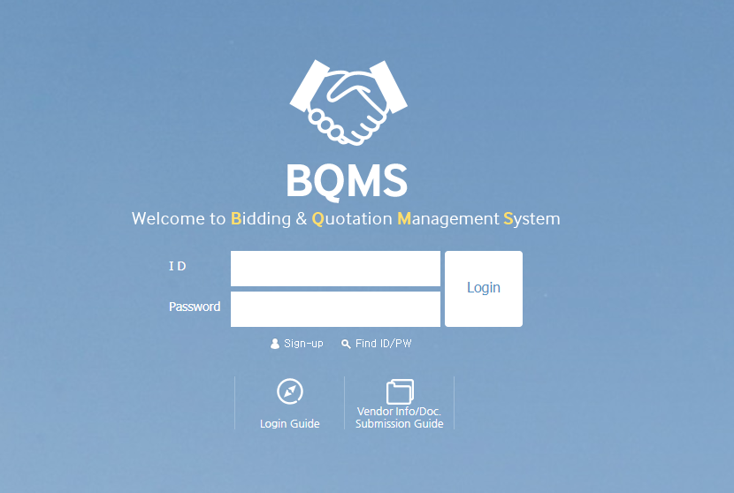
1. Vendor Account Registration
Click ‘Vendor Info/Doc. Submission Guide’

Slide 6
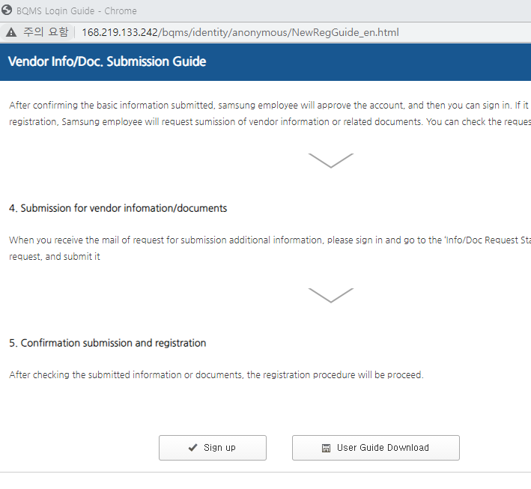
1. Vendor Account Registration
After checking the popup contents, click ‘Sign up’.
If you already have BQMS account and received ‘Request for Info/Doc submission’ mail, you can sign in without sign up.

Slide 7
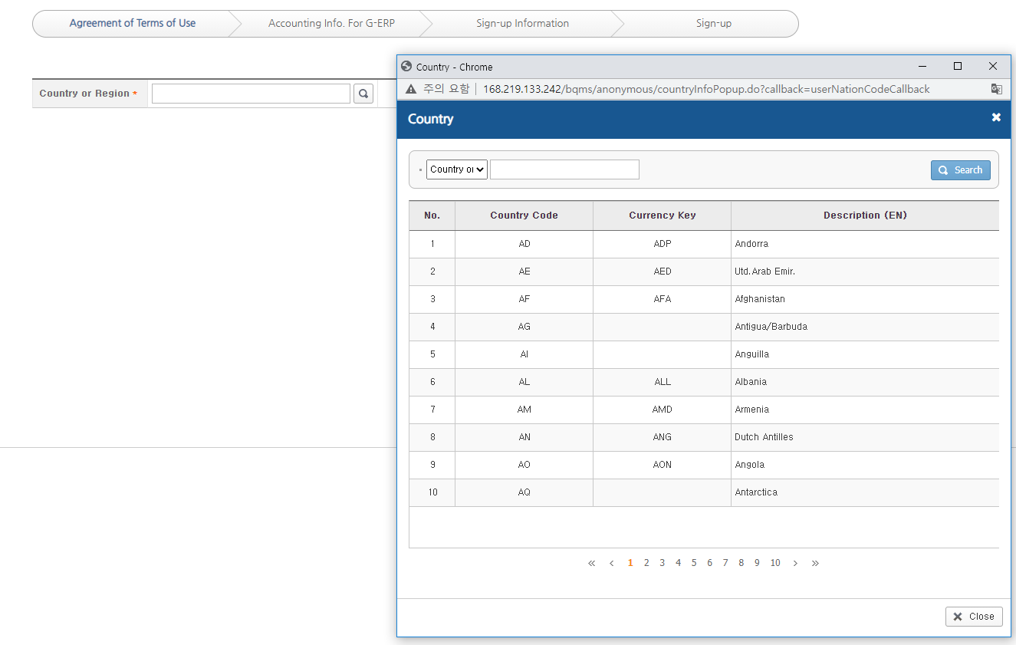
1. Vendor Account Registration
Search and select a country.

Slide 8
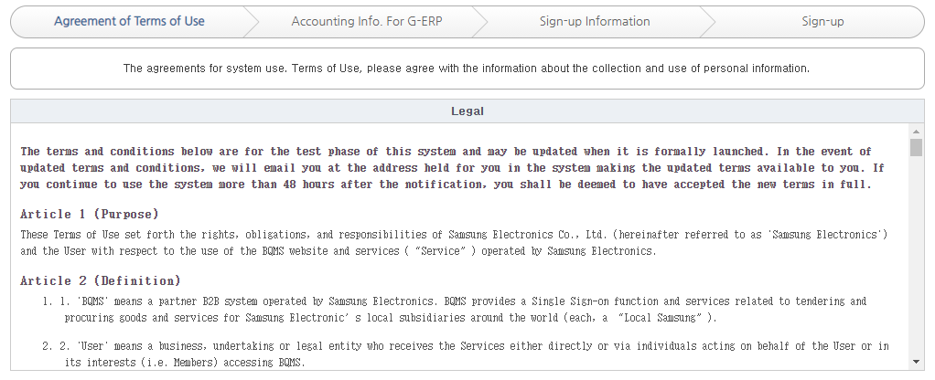
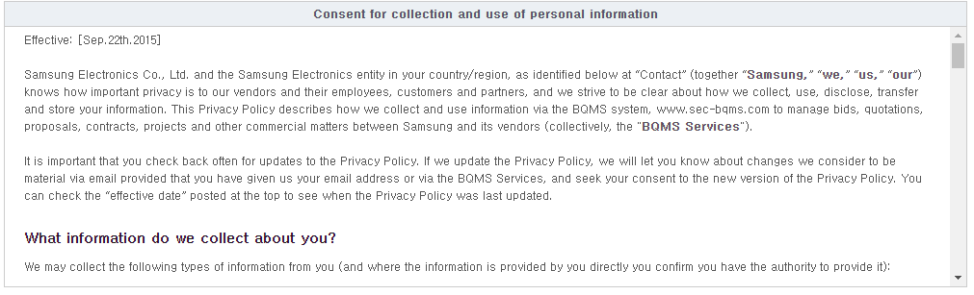
1. Vendor Account Registration
Check the Terms and Conditions and the personal information collection agreement and then click Next.

Slide 9
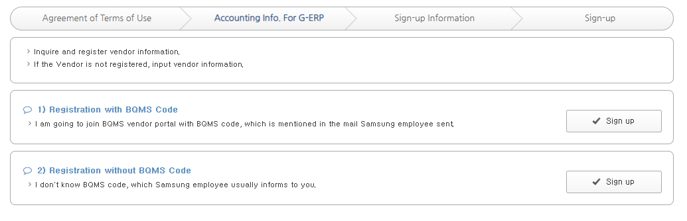
1. Vendor Account Registration
Check the mail received from the samsung employee and choose one of the ‘1) Registration with BQMS Code’ or ‘2) Registration without BQMS Code’.
- 1) ‘Registration with BQMS Code’ : Vendor information is already registered, but there’s no active user account. It will be linked with exisiting vendor after approval.
- 2) ‘Registration without BQMS Code’ : In case of new registration without both vendor info and user account.
When you sign up with the BQMS Code, you must search and select the BQMS Code in the mail received from Samsung employee.
If you proceed without BQMS Code despite the existence of the BQMS code, you must sign up again.

Slide 10
1. Vendor Account Registration – A. Registartion with BQMS Code
If there is BQMS Code in the mail received, select ‘Registration with BQMS Code’.

Slide 11
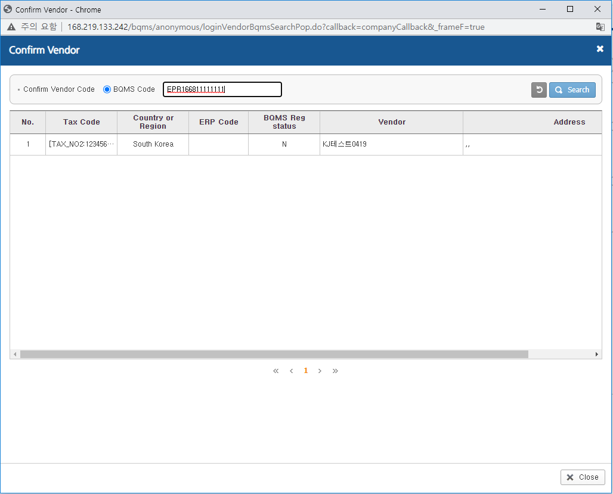
1. Vendor Account Registration – A. Registartion with BQMS Code
Search by the BQMS code in the e-mail and select it.

Slide 12
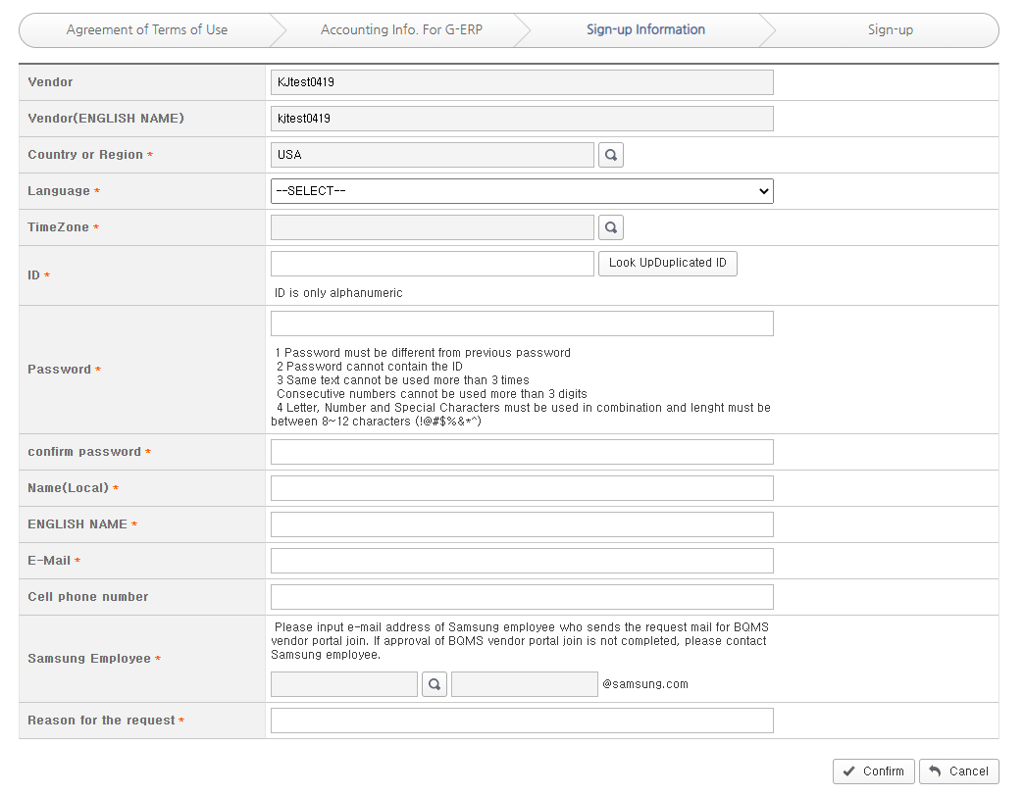
1. Vendor Account Registration – A. Registartion with BQMS Code
Fill in the required information and click the ‘Confirm’ button. (Please enter the samsung employee’s mail address who sent the registration request e-mail. )

Slide 13
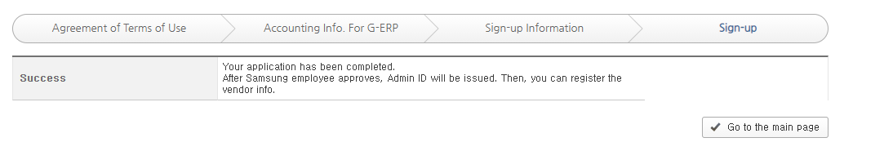
1. Vendor Account Registration – A. Registartion with BQMS Code
A request has been made to approve the subscription to the samsung employee. When you receive an e-mail that the approval has been completed, you can sign in and proceed with the vendor information / document submission.

Slide 14
1. Vendor Account Registration – B. Registartion without BQMS Code
If there is no BQMS Code in the mail received from samsung employee, select the ‘Registration without BQMS Code’.

Slide 15
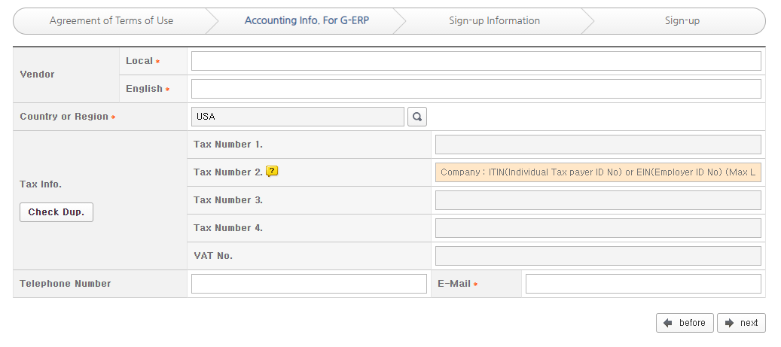
1. Vendor Account Registration – B. Registartion without BQMS Code
Fill in the required information and check tax duplicate.
3. If there is duplicate, check the BQMS Code in the pop-up message and return to the previous step and proceed to ‘Registration with BQMS Code'.
4. If no duplication occurs, click Next.

Slide 16
1. Vendor Account Registration – B. Registartion without BQMS Code
Fill in the required information and click the ‘Confirm’ button. (Please enter the samsung employee’s mail address who sent the registration request e-mail. )

Slide 17
1. Vendor Account Registration – B. Registartion without BQMS Code
A request has been made to approve the subscription to the samsung employee. When you receive an e-mail that the approval has been completed, you can sign in and proceed with the vendor information / document submission.

Slide 18
2. Info/Doc. Request Status and Submission
After account has been approved and received a request for the vendor info or doc. submission, sign in.

Slide 19
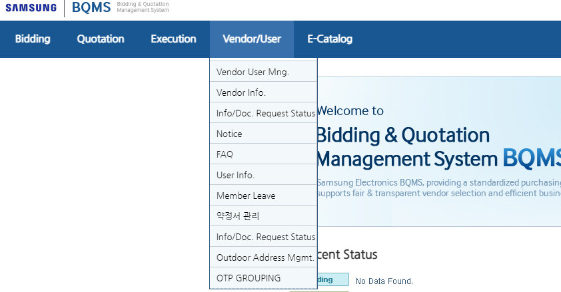
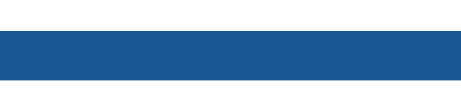
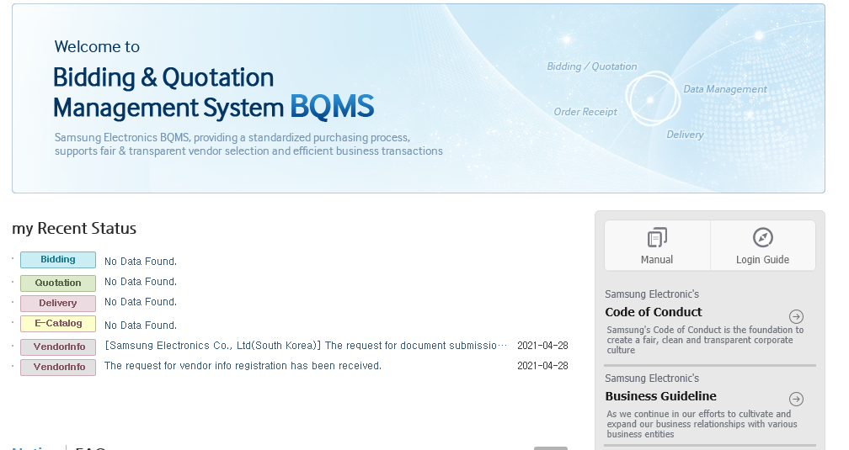
2. Info/Doc. Request Status and Submission
After sign-in, you can check requests for a submission about vendor info/doc. from the samsung employee at the main.
When you click each item, you can go to the ‘Info/Doc. Request Status’ menu. (‘Administrator – Info/Doc. Request Status’)
There are two types of requestes :
- Vendor Info : Basic Information of the vendor. (Address, contact information, CEO/Representative information, Financial information, Credit rating information, etc. )
- Documents : Various documents required for registration.

Slide 20
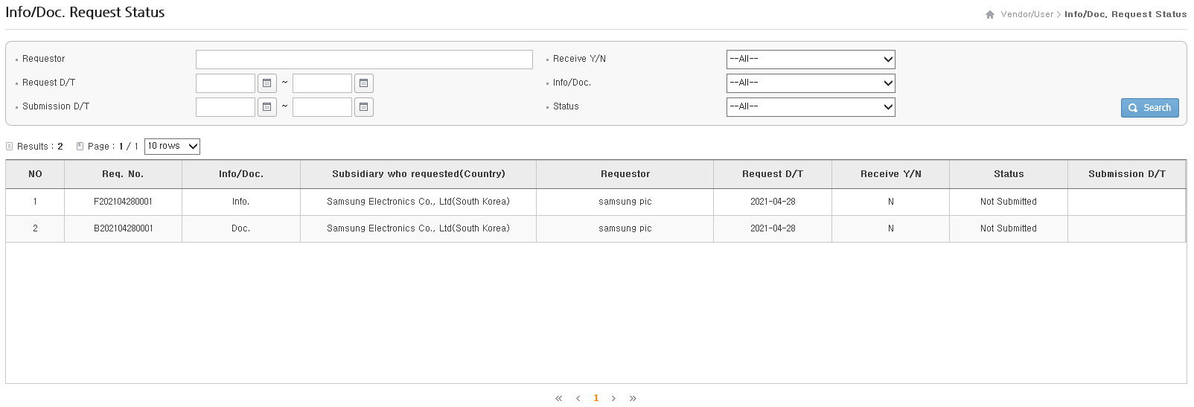
2. Info/Doc. Request Status and Submission
You can check the request for submission additional information from the samsung employees.
① Info/Docs. : Submission items are divided into the following two types.
- Vendor Info : Basic Information of the vendor. (Address, contact information, CEO/Representative information, Financial information, Credit rating information, etc. )
- Documents : Various documents required for registration.
② Subsidiary who requested (Country) : You can check the requester’s company and country.
③ Requestor : Name of Samsung employee who requested.
④ Receive Y/N : It indicates whether the request has been opened or not.
⑤ Status : It indicates whether the request has been submitted or not.
- Not submitted : The request has not been submitted.
- Submitted : The request has been submitted.
Once submitted, the request cannot be resubmitted. If you need to resubmit it, please ask the samsung employee to make a request again.
①
②
③
④
⑤

Slide 21
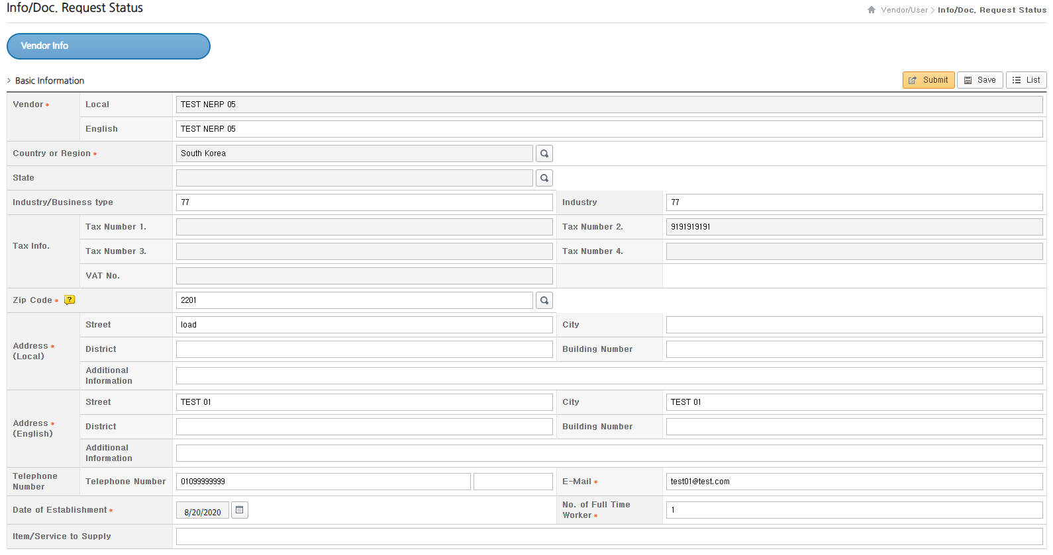
2. Info/Doc. Request Status and Submission – A. Vendor Info. Submission(1/3)
In this page you can fill the vendor information and submit it. (You have to fill in all mandatory items.)
2. The information submitted will be reflected after verification. Please fill in all the required information correctly.

Slide 22
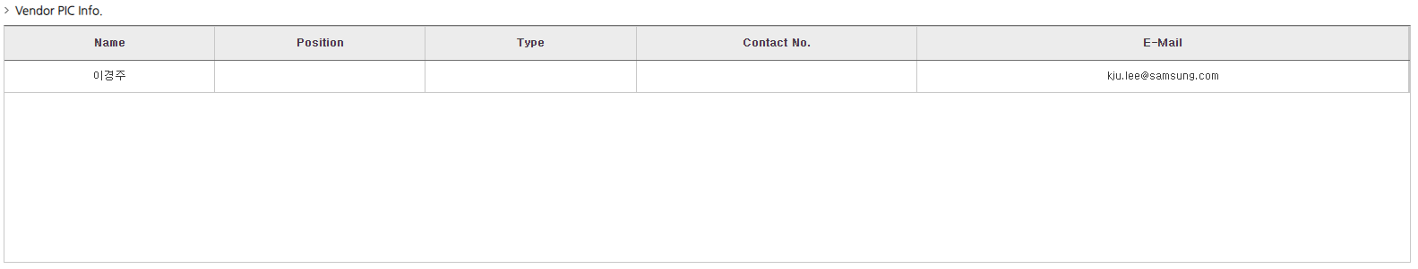
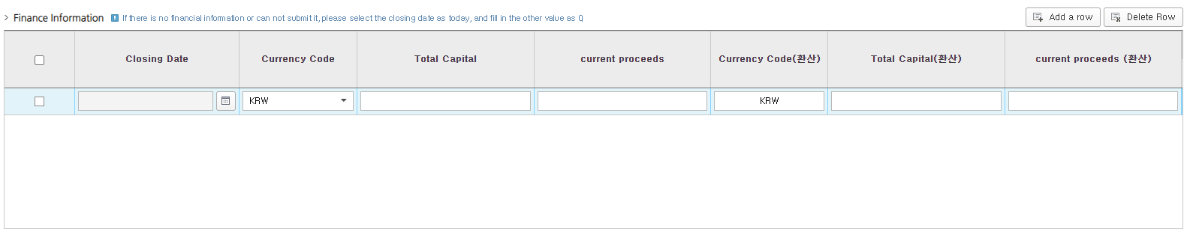
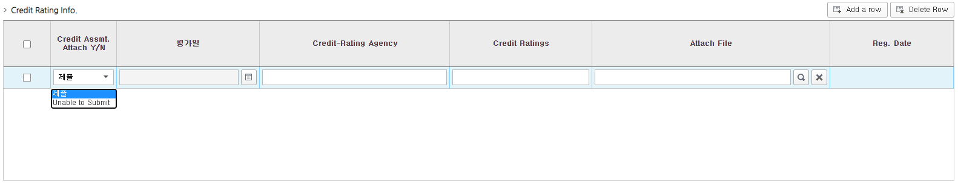
2. Info/Doc. Request Status and Submission – A. Vendor Info. Submission(2/3)
Vendor PIC Info. : User accounts joined by the same BQMS code are automatically interlocked.
Finance Information : It is the required input value, so please enter the financial information by clicking ‘Add a row’ button.
If there is no financial information for a specific reason such as a new company, please submit the settlement date today and the other value as 0.
Credit Rating Info. : It is the required input value, so please enter the creding rating info. and upload the credit report file.
If there is no credint rating information for a specific reason such as a new company, please select the ‘credint Assmt. Attach Y/N’ as ‘Unable to Submit’.
①
②
③

Slide 23
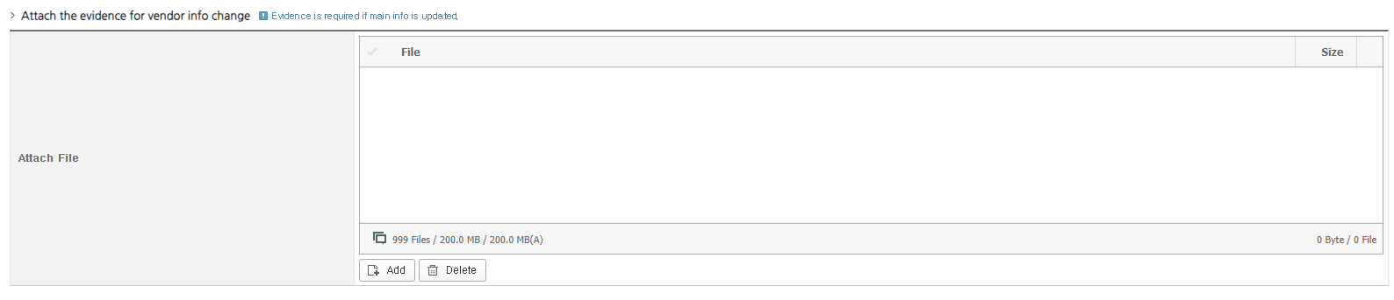
2. Info/Doc. Request Status and Submission – A. Vendor Info. Submission(3/3)
If you modify some key information item after the vendor is already registered, it is necessary to attach a proof document for the change.
Please upload the official document that can prove the change. (Business registration certificate, etc. )
* Items needed proof document attachment : Vendor Name (Local, Eng), zip code, address(Local, Eng) and CEO/President of Vendor.

Slide 24
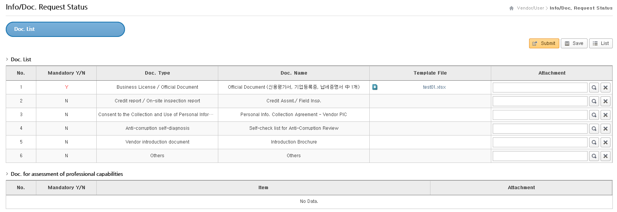
2. Info/Doc. Request Status and Submission – B. Doc. Submission
Click the request for a docs. submission in theInfo/Doc. Request Status list.
Doc. List : Documents list required for registration.
Doc. for assessment of professional capabilities : Additional data that can be referred to registration procedure.
① Mandatory Y/N : You must fill out the items with mandatory value of Y.
② Template File : If some doc. has certain template, you need to fill in the template and attach it.
③ Attachment : Where you can attach doc.
4. After uploading all required documents and then click ‘submit’. Before submitting, you can save temporarily with ‘Save’ button.
①
②
③

Slide 25
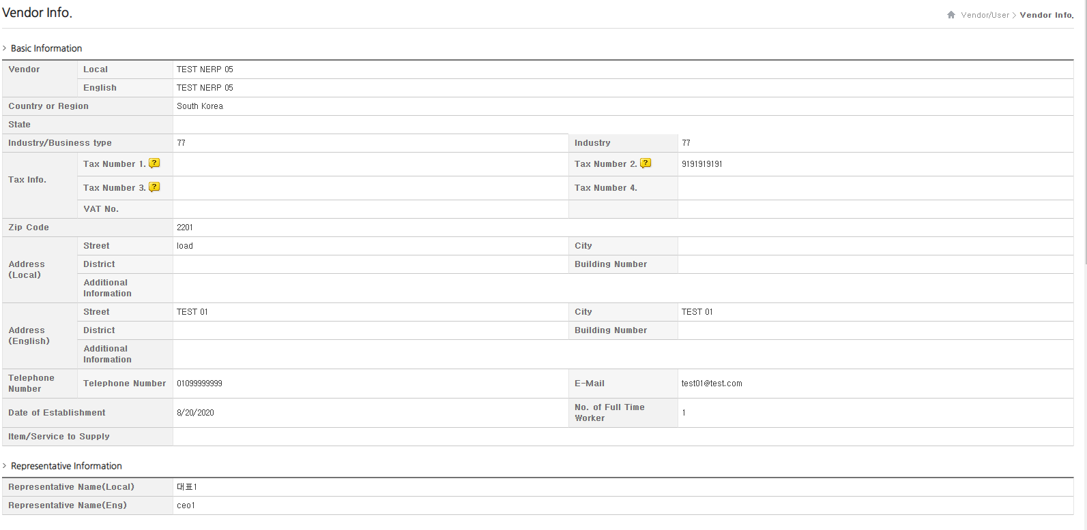
3. Confirmation Vendor Info. Reflection
Submitted informations and documents will be applied after confirmation of Samsung employees.
You can check reflected information and document at the ‘Administrator – Vendor Info.‘ menu.
This menu is only for check reflected information and in order to revise info. or doc., it needs a request from samsung employees.

